Slide 1


Slide 2


Equality Act 2017
Harmonise & extend statutory protection from discrimination for wider range of people
Aim is to ensure equal access in:
Employment
Goods & Services
Education
Public Functions
Premises
Associations
Notes:
Izzard/Cull v Independent Methodist Church 2013

Slide 3
Societal Benefits of Equality
Societal Benefits of Equality
Equal Access
Equal Opportunities
Fairness
Inclusion
Less Isolation
Kindness, compassion & respects

Slide 4

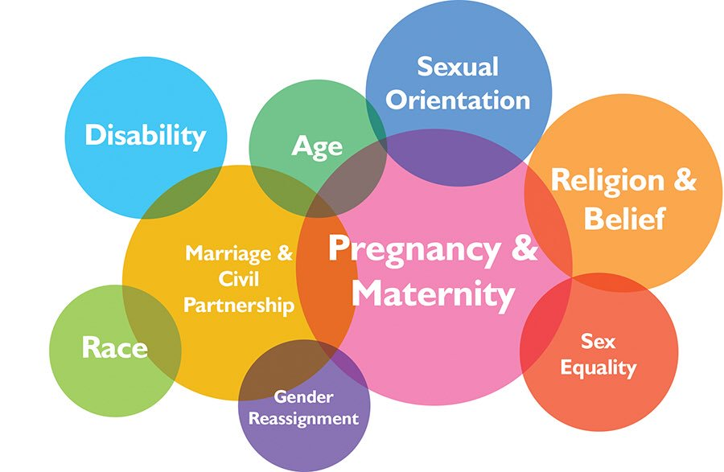
9 Protected Characteristics
Race (includes colour, nationality, ethnic or national origin)
Sex
Religion or Belief (or lack of religion or belief)
Sexual Orientation
Gender Reassignment
Marriage and Civil Partnership
Pregnancy and Maternity
Age
Disability
Notes:
Most discrimination is unintended. It is the not knowing or not understanding that creates issues. Ignorance though is no defence.

Slide 5
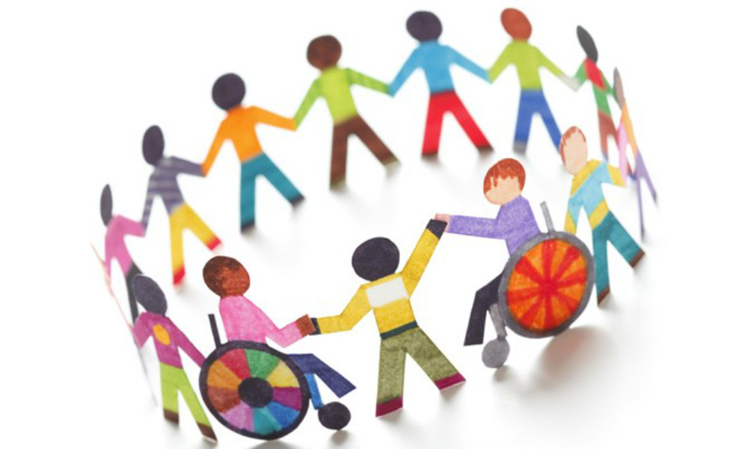

Forms of Discrimination

Slide 6
Types of Discrimination
Direct
Indirect

Slide 7
Direct Discrimination
Being treated less favourably on the
grounds of a protected
characteristic they possess.
Cannot justify direct discrimination except on grounds of age
Notes:
The Act defines the various kinds of discrimination with reference to the characteristics which are protected under the Act. Whilst these types of discrimination largely replicate those found in previous legislation there are some important changes which materially alter the scope of protection. Some examples of direct discrimination a are:
a company only shortlists male job applicants for an interview because they assume women will not fit in
an employer refuses to let an employee go on a residential team building event because they are a wheelchair-user
a company does not offer a training opportunity to an older member of staff because they assume that they would not be interested, and the opportunity is given to a younger worker.
Direct discrimination cases are frequently won or lost on the basis of the claimant’s ability to identify a suitable actual comparator, or sometimes, to
construct helpful hypothetical comparators.
To demonstrate discrimination a claimant would need to compare the treatment that they have received with the treatment of someone else who doesn't have the same protected characteristic. The Equality Act calls this person a comparator.
The comparator is someone who’s in the same or similar enough situation as the claimant, but who doesn’t have the same protected characteristic.
What's meant by someone in a similar enough situation?
It’s not necessary for the claimant to be in an identical situation as the comparator. But there must be sufficient similarities between the two to show that the reason for the worse treatment is the protected characteristic and not something else.
The comparator can be a real person. But, sometimes it’s not possible to find a real person who’s in the same or similar enough situation because the situation has never happened before. If this is the case, you can use a hypothetical comparator.
Discrimination Questionnaires abolished
With effect from 6 April 2014, the statutory discrimination questionnaire procedure was abolished. The procedure was designed to allow an individual who believed that they had been unlawfully discriminated against, harassed or victimised to obtain information from his or her employer by means of a specified questionnaire process. A failure by the employer to answer the questions or evasive answers would allow a tribunal to draw adverse inferences in any subsequent legal proceedings. For those employers unfortunate enough to having experienced being served with such a questionnaire, the questions could be very lengthy and involve considerable work.
Employees can still ask employers questions and a court may choose to draw an adverse inference from a refusal by the employer to answer those questions, but there will no longer be a statutory process for doing so.
Needless to say, any employer who receives a set of questions from an employee who believes that he or she has been discriminated against would be ill-advised to ignore this request and should consider taking legal advice.

Slide 8


Direct Discrimination Through Association
Direct discrimination against
someone because of their
association with a person
who possesses a protected
characteristic.
Act will protect a disabled guest for example, as well as a person associated with that guest
refusing the booking of a non-disabled couple because it was known they have a disabled child which they might bring with them
making the carer of a disabled person sleep in the same room to ensure that they don’t disturb other guests.
Notes:
Coleman v Attridge Law
Sharon Coleman claims that she was forced to resign from her position as a legal secretary with Attridge Law. Although not disabled herself, her son suffers from congenital breathing difficulties and requires specialist care. Following her return to work after the birth of her son, Ms Coleman alleges that she was singled out by her employer for discriminatory treatment because of her disabled son. Ms Coleman said she was described as "lazy" when she asked for time off to look after her child, and that she was refused permission to work from home, when her child needed an operation. The Court held that the purpose of the Directive and subsequently Equality Act was to combat all forms of discrimination on the grounds of disability

Slide 9
Direct Discrimination by Perception
Discrimination based on the
perception that a person
possesses a protected
Characteristic.
Avoid treating someone less favourably because you think they have a particular characteristic
Notes:
This is direct discrimination against an individual because others think they possess a protected characteristic.
It applies even if the person does not actually possess that characteristic.
It also applies when it is known that the person does not have that protected characteristic.
Case English v Sanderson Blinds
A heterosexual employee whose working environment was allegedly made intolerable because he was repeatedly subjected to homophobic taunts was harassed on grounds of sexual orientation, notwithstanding that, as he was aware, his tormentors did not believe him to be gay.
The actual or perceived sexual orientation of the subject of homophobic abuse is irrelevant. Such behaviour creates a degrading and hostile working environment on grounds of sexual orientation.

Slide 10
Indirect Discrimination
Where a provision, criterion
or practice is applied equally,
but has the effect of putting
a person with a protected
characteristic at a
disadvantage when
compared to others.
Notes:
Indirect discrimination occurs when a policy or practice that applies to everyone particularly disadvantages a group of people who share a protected characteristic. Indirect discrimination under the Act is defined as follows: A person (A) discriminates against another (B) if A applies to B a provision, criterion or practice which is discriminatory in relation to a relevant protected characteristic of B's.
The Equality Act does not define a “provision, criterion or practice”. However, in the workplace, the term is most likely to include an employer’s policies, procedures, rules and requirements. Examples might include recruitment selection criteria, contractual benefits, a redundancy scoring matrix or any other work practice, whether written down or not.
Examples of possible indirect discrimination
Owing to the importance of good timekeeping, all applicants must live within 3 miles of our factory – Employers are entitled to expect good timekeeping and it is for the employee to make the necessary arrangements to ensure they arrive for work on time. How they do it is not usually the concern of the employer. It is not unusual for people from minority ethnic groups to live in particular areas. By limiting applicants to a particular area of residence you may be preventing people of different ethnic groups from applying.
Job applicants should have 3 years recent related experience in a similar job – Women, who make up the majority of carers, may have taken time out of work to raise children. They are therefore less likely to have ‘recent’ experience. The statement may also discriminate on grounds of age. Younger people may not have had recent experience.
EMPLOYERS NEED TO ASK THEMSELVES WHY IS THIS REQUIREMENT NECESSARY

Slide 11

Objective Justification
Possible to defend indirect discrimination claim by arguing practice or treatment is justified.
To be successful in the defence:
Show there is a good business reason – “legitimate aim”
That the way of doing it is appropriate, necessary, fair and reasonable – “proportionate means” and in doing so has considered any other less discriminatory ways of achieving the legitimate aim
Notes:
Sometimes you can justify indirect discrimination…to achieve ‘legitimate aims’ of the business
Employers should note that proving ‘a proportionate means of achieving a legitimate aim’ can be a difficult process.
Direct discrimination because of age is the only form of direct discrimination which may be objectively justified. Indirect discrimination is potentially justifiable in all of the relevant protected characteristics.
In attempting to demonstrate ‘a proportionate means of achieving a legitimate aim’, an employer must show:
there is a legitimate aim such as a good business reason, but employers should note that cost alone is unlikely to be considered sufficient and;
the actions are proportionate, appropriate and necessary, there is not another way to achieve the same aim which would be ‘less discriminatory’, it can show it has been fair and reasonable, and has looked for a ‘less discriminatory’ alternative.
Both points apply in justifying ‘a proportionate means of achieving a legitimate aim’, not just one of them.
The process of determining whether discrimination is justified involves weighing up the employer’s need against the discriminatory effect on the employee or group of employees with the protected characteristic.
Employers should closely scrutinise whether any discriminatory act, policy, procedure or rule can really be justified. For example, is there another way of achieving the same aim which would be less discriminatory?
It is important to stress that employers should carefully monitor their policies and practices, otherwise they may inadvertently indirectly discriminate. For example, policies and practices which were not discriminatory when they were first introduced may become discriminatory over time, perhaps because of a change in the composition of the workforce.
For example… discrimination which is potentially lawful A small finance company needs its staff to work late on Friday afternoons to analyse stock prices in the American finance market. The figures arrive late in the day because of the time difference, where London is five hours ahead of New York. During the winter, some staff would like to be released early on Friday afternoons to be home before sunset – a requirement of their religion.
They propose to make up the time during the rest of the week. The company is not able to agree to the request because the American figures are necessary to the business, they need to be worked on immediately and the company is too small to have anyone else do the work.
The requirement to work late on Friday afternoons is unlikely to be unlawful indirect discrimination as it could be seen as a proportionate response to achieving a legitimate business aim and there is no alternative course available.

Slide 12
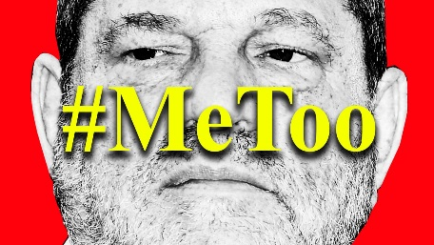


Unwanted conduct in relation to a protected characteristic
Being treated less favourably due to rejection of or submission to unwanted conduct of a sexual nature or that is related to gender reassignment or sex
Unwanted conduct of a sexual nature
HARASSMENT
A person harasses another if that person engages in….
Which violates a person’s dignity and creates a hostile, humiliating, intimidating, degrading or offensive environment
NB. CLAIMANT MAY NOT HAVE BEEN INTENDED RECIPIENT OF HARASSMENT

Slide 13

Victimisation
Victimisation is when a person is subject to a
detriment because they have (or are believed to have):
Made an allegation of discrimination.
Supported a complaint of discrimination.
Given evidence relating to a complaint.
Raised a grievance concerning discrimination.
Notes:
Victimisation may also occur because an employee is suspected of doing one or more of these things.
Also includes unfavourable treatment on the grounds that an employee might bring a case or use the legislation.
PLEASE STRESS THAT THE ABOVE IS THE LEGAL DEFINITION OF VICTIMISATION – TERM OFTEN MISUNDERSTOOD

Slide 14
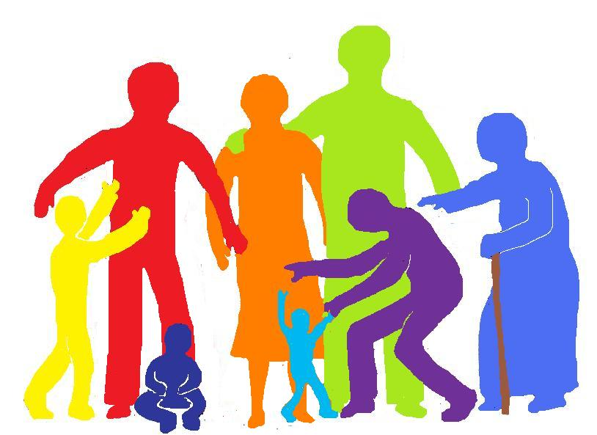
Age
Protects people of all ages – both older and younger
Notes:
OPTIONAL
The Equality Act protects employees from discrimination, harassment and victimisation relating to any and all ages as well as if they are discriminated against because they are ‘younger’ or ‘older’. For example if an organisation has a training policy excluding employees aged 60 or more from applying for courses then this is likely to be discriminatory. However, under the Act, limited exceptions in some others including pay and other employment benefits, can be allowed based on length of service.

Slide 15

Disability
A disabled person is defined as someone who has:-
a physical or mental impairment which has
a substantial and
a long-term
adverse effect on their ability to carry out normal day to day activities.
Cancer, MS, HIV and Aids are disabilities
Notes:
OPTIONAL
The Act has made it easier for a person to show that they are disabled and protected from disability discrimination. Under the Act, a person is disabled if they have a physical or mental impairment which has a substantial and long-term adverse effect on their ability to carry out normal day-to-day activities, which would include things like using a telephone, reading a book or using public transport.
Who is classed as disabled under the Act?
To be protected under the Act, workers have to show that they have a “physical or mental impairment which has a substantial and long-term adverse effect on their ability to carry out normal day-to-day activities.”
People do not lose their right to protection against discrimination because they have been able to control or correct their disability - for example by medical treatment or the use of aids. So the effect of the treatment must be disregarded when assessing whether or not someone is disabled. This provision does not apply to someone who wears glasses or contact lenses.
People who have had a disability in the past are covered under the Act, as are people with progressive conditions and anyone deemed to have a disability such as those who have been diagnosed with HIV, cancer and multiple sclerosis.
Babies and children under the age of six who have an impairment are also covered. This is significant for the purposes of associative discrimination so that the parent of a child with an impairment will be protected even if the child’s condition does not yet have a substantial adverse effect on the child’s ability to carry out normal day-to-day activities, but may do in the future.
How long is “long-term”?
To satisfy the definition in the Act, the disability must:
Have lasted at least 12 months, or;
Be likely to last at least 12 months, or;
Be likely to last for the rest of the person’s lifetime (if less than 12 months).
The Act also covers people whose condition may involve periods of remission. Although the impairment may no longer have an adverse effect, it will still be deemed to have that effect if it is “likely to recur”.
The Act puts a duty on an employer to make reasonable adjustments for your staff to help them overcome disadvantage resulting from an impairment (eg by providing assistive technologies to help visually impaired staff use computers effectively).
The Act includes protection from discrimination arising from disability. This states that it is discrimination to treat a disabled person unfavourably because of something connected with their disability (eg a tendency to make spelling mistakes arising from dyslexia). This type of discrimination is unlawful where the employer or other person acting for the employer knows, or could reasonably be expected to know, that the person has a disability.
Additionally, indirect discrimination covers disabled people. This means that a job applicant or employee could claim that a particular rule or requirement you have in place disadvantages people with the same (would their be better than same) disability. Unless you could justify this, it would be unlawful.
Protects employees from discrimination, harassment and
victimisation because of disability

Slide 16
Disability Discrimination
Making reasonable adjustments
Treating disabled persons more favourably because of their disability than non-disabled persons
Failure to make reasonable adjustments is unlawful.
Non-disabled person cannot claim discrimination on the grounds that they are treated less favourably.
Notes:
Making reasonable adjustments
An employer can lawfully treat employees who are disabled more favourably because of their disability than non-disabled employees.
However, employees who are not disabled are unable to claim discrimination on the grounds they have been treated less favourably because of the ‘reasonable adjustments’ given to a disabled colleague
An employer must consider making ‘reasonable adjustments’, involving the disabled employee or job applicant in the decision, if:
it becomes aware of their disability
a disabled employee or job applicant asks for adjustments to be made
a disabled employee is having difficulty with any part of their job
either an employee’s sickness record, or delay in returning to work, is linked to their disability
Further, there are three questions an employer should consider in assessing what reasonable adjustments might need to be made:
1. Does it need to change how things are done?
For example… The employer’s policy is to only offer car parking spaces to senior managers. However, an employee who is not a manager has developed a mobility impairment and needs to park very close to the office. The employee is allocated a parking space. This is likely to be a reasonable adjustment to the employer's car parking policy.
2. Does it need to physically change the workplace?
For example… Clear glass doors at the end of a workplace corridor present a hazard for a visually-impaired employee. The employer adds brightly coloured strips at eye level that can be more easily seen by the employee. This is likely to be a reasonable adjustment.
3. Does it need to provide extra equipment or get someone to assist the disabled employee in some way?
For example… As a reasonable adjustment, the employer provides specialist software for an employee who has developed a visual impairment. Their job involves using a computer, and the software enables them to continue in the role.
But whether any suggested adjustments are actually reasonable can depend on whether:
they are practical for the employer to make
the employer has the resources to pay for them? An employment tribunal may expect more from a large organisation than a small one because it may have greater means, or if an organisation has access to other funding such as the Government’s Access to Work (LINK) scheme.
they will be effective in overcoming the ‘disadvantage’ in the workplace
In considering reasonable adjustments for a disabled employee or job applicant, an employer should meet with them to discuss what can be done to support them. While an employer has a legal duty to make ‘reasonable adjustments’, there may be times when suggested changes are unreasonable and it can lawfully refuse to make them.
Making reasonable adjustments can be a complex area. The Equality Adviser and Office of Fair Trading can provide further guidance.#
When making reasonable adjustments
There are some circumstances where an employer can lawfully treat employees who are disabled more favourably because of their disability than non-disabled employees. In fact, it is unlawful for an employer to fail to make ‘reasonable adjustments’ enabling a disabled person to work for it.
A disability is a physical or mental impairment which has a substantial and long-term effect on the person’s ability to carry out normal day-to-day activities.
In turn, employees who are not disabled are unable to claim discrimination on the grounds they have been treated less favourably because of the ‘reasonable adjustments’ given to a disabled colleague.
An example of a ‘reasonable adjustment’ might include changing a disabled employee’s terms and conditions of employment or working arrangements, so they will not be disadvantaged by their disability in doing their job compared to colleagues who are not disabled, and/or so they and their work performance really benefit from the change.

Slide 17
Reasonable Adjustments
Duty is anticipatory – plan ahead
Adjustments to a policy or procedure
Adjustments involving the provision of auxiliary aids and services
Adjustments to physical features
Take advice – Crossroads Care Tiered Award Scheme

Slide 18
Direct disability discrimination
Make sure you treat disabled guests the same as you treat other guests. You would be treating guests with disabilities less favourably if you:
refuse to serve them
offer less favourable terms
offer a lower standard of service compared with what you normally offer.

Slide 19

Disability Discrimination in employment
You should not ask job applicants to complete a pre-employment medical questionnaire
You should not ask health related questions generally unless:
Exceptions:
Employers can therefore ask health-related questions:
to help decide if reasonable adjustments are needed in the selection process
to determine if an applicant can carry out a function that is essential to the job such as heavy lifting, or
for diversity monitoring purposes.
Notes:
Under the Equality Act 2010 (the Act) it is unlawful, except in certain circumstances, for employers to ask about a candidate’s health. Therefore employers should not usually ask health questions at all until a job offer has been made. Many employers who routinely use pre-employment health questionnaires should have abandoned or radically changed them since provisions under the Act came into force
Exceptions
The Act limits the circumstances when employers can ask pre-employment health-related questions before offering the position. Some pre-employment health enquiries are allowed for certain specified purposes set out in the bullet points below. The questions are allowed if it is necessary to establish whether the applicant can carry out a function that is intrinsic to the work concerned. However, employers should only ask questions that relate to the applicant's ability to perform the core duties of the role.
Employers can therefore ask health-related questions:
to help decide if reasonable adjustments are needed in the selection process
to determine if an applicant can carry out a function that is essential to the job such as heavy lifting, or
for diversity monitoring purposes.

Slide 20
Disability arising from discrimination
Differs from direct discrimination because of a protected characteristic – person discriminated against must show less favourable treatment compared to a person without that characteristic. This discrimination cannot be objectively justified.
Treating a disabled person unfavourably because of something arising in consequence of their disability. The treatment may be able to be objectively justified.
Examples:
banning a person with Tourette's syndrome from a bar area because their outbursts may offend other customers
providing plastic cups and plates to a person with muscular dystrophy because you think that they might break items.

Slide 21
Examples of things connected to a disability:
the need for regular toilet breaks
the need to take time-off work
long-term sickness absence
restricted diet
need for an assistance dog
behavioural issues
speech or movement difficulties
difficulties reading and writing or understanding certain things
the need for specialist computer equipment
the need for a quiet working environment
the need to use a wheelchair or other special equipment.

Slide 22

Reasonable Adjustments Financial Support
Employment
Disabled Persons (Employment) Scheme 1999
Up to £10,000 per applicant
Services/Premises/Business
Business Improvement Scheme - consultancy
Government review to identify if scheme to support private sector to make reasonable adjustments can be offered

Slide 23

Gender Reassignment
Provides protection for trans people – someone who proposes to, starts or has completed a process, or part of a process, to change his or her sex.
An individual does not have to be under medical supervision to be protected.
Notes:
OPTIONAL
The Equality Act protects employees from discrimination, harassment and victimisation relating to gender reassignment. In the Act someone who proposes to, starts or has completed a process , or part of a process to change his or her gender is referred to as a ‘transsexual’.
Before the Equality Act, people reassigning their sex had to be under medical supervision to be covered, but this is no longer the case. For example, a female employee who decides to live as a man, but does not undergo any medical procedures, must not be harassed when they are living permanently as a man and begin using the male toilet.
It is discriminatory to treat a transsexual employee less favourably for being absent from work because they propose to undergo, are undergoing or have undergone gender reassignment. An employer must not treat them any differently than it would if they were absent because they were ill or injured.
In law, cross-dressers are not regarded as transsexual people as they do not intend to live permanently in the gender opposite to their sex at birth. While they are not specifically protected under the Act as cross-dressers, if they are bullied because they are perceived to be transsexual or have a particular sexual orientation, they may be in a position to claim discrimination under the relevant protected characteristic/s.
However, employers and employees should not try to make a distinction whether a colleague is a cross-dresser or transsexual and regard the colleague in the gender identity they ‘present in’, whether temporarily or permanently.
The Act protects employees from discrimination, harassment and victimisation because of gender reassignment.

Slide 24
Gender Reassignment
Respect the individuals right to be identified as the sex they have chosen
Use the appropriate pronoun to the sex they identify with
Don’t ask for evidence of the sex they are
Allow individual to use the toilets of the sex they have chosen
Think about gender neutral toilets if this is an option
Don’t direct a trans person to the disabled toilet – being trans is not a disability
Notes:
OPTIONAL
The Equality Act protects employees from discrimination, harassment and victimisation relating to gender reassignment. In the Act someone who proposes to, starts or has completed a process , or part of a process to change his or her gender is referred to as a ‘transsexual’.
Before the Equality Act, people reassigning their sex had to be under medical supervision to be covered, but this is no longer the case. For example, a female employee who decides to live as a man, but does not undergo any medical procedures, must not be harassed when they are living permanently as a man and begin using the male toilet.
It is discriminatory to treat a transsexual employee less favourably for being absent from work because they propose to undergo, are undergoing or have undergone gender reassignment. An employer must not treat them any differently than it would if they were absent because they were ill or injured.
In law, cross-dressers are not regarded as transsexual people as they do not intend to live permanently in the gender opposite to their sex at birth. While they are not specifically protected under the Act as cross-dressers, if they are bullied because they are perceived to be transsexual or have a particular sexual orientation, they may be in a position to claim discrimination under the relevant protected characteristic/s.
However, employers and employees should not try to make a distinction whether a colleague is a cross-dresser or transsexual and regard the colleague in the gender identity they ‘present in’, whether temporarily or permanently.
The Act protects employees from discrimination, harassment and victimisation because of gender reassignment.

Slide 25

Sexual Orientation
Protects bisexual, gay, lesbian and
heterosexual people from discrimination.
Notes:
OPTIONAL
The Equality Act protects employees from discrimination, harassment and victimisation relating to sexual orientation. It applies equally to bisexual, gay, heterosexual and lesbian orientations. For example, an employer must ensure that an employee who is perceived to be bisexual (whether they are or are not is irrelevant) is not bullied by colleagues.

Slide 26
Bull v Preddy
Mr & Mrs Bull, Christian hotel owners
Mr Preddy & Mr Hall, civil partners
Refused to honour booking of double room as such rooms reserved for heterosexual married couples only
Court said Preddy & Hall directly discriminated against on the grounds of their sexual orientation
Bulls argued right to manifest religious belief (human right)
Court stated the right to manifest religious belief could be limited where it interfered with the rights of others
Decision applied in Black v Wilkinson, B&B owner objected to sexual relations outside marriage; court stated direct discrimination on grounds of sexual orientation

Slide 27

Marriage and Civil Partnership
Employees who are married or in a civil partnership are protected against discrimination.
Single people and couples in relationships which are not legally recognised are not protected.
Notes:
OPTIONAL
The Equality Act protects employees from general direct discrimination, indirect discrimination and victimisation because of marriage or civil partnership. For example, an employee must not be ignored for promotion because they are married. However, single people and couples in relationships that are not legally recognised are not protected.
Direct discrimination by perception or association and harassment because of this characteristic are not covered by the Equality Act , but there is other legislation where such claims might be made.

Slide 28
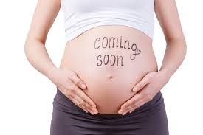
Pregnancy and Maternity
Women are protected against
discrimination on the grounds of pregnancy and maternity during the period of their pregnancy and any maternity leave to which they are entitled.
Notes:
OPTIONAL
The Equality Act protects an employee from general direct discrimination and victimisation because of their pregnancy or for taking/seeking to take maternity leave. For example, an employer must not take into account pregnancy-related illness when considering other sickness absence or in making a decision about her employment. During this time, any other discrimination because of her sex would be a separate matter.
The difference between pregnancy and maternity discrimination and the other characteristics is that a woman who is pregnant or on maternity leave cannot be treated unfavourably because of her pregnancy or maternity leave. That means there is no need for her to show that she has been treated less favourably than a man, or a woman who was not pregnant, just that she was in fact treated detrimentally because of pregnancy or maternity.
Protects an employee from general direct discrimination and victimisation because of their pregnancy or for taking/seeking to take maternity leave.

Slide 29

Race
People are protected from discrimination because of their race.
Race includes colour, nationality, ethnic or national origin.
Howe v JD Wetherspoon
Notes:
OPTIONAL
The Equality Act protects employees from discrimination, harassment and victimisation because of race. Race, colour, nationality and ethnic or national origin are all covered under this characteristic. For example, an employer must not allow employees to make racial slurs against Eastern European colleagues. Additionally, a racial group can be made of up of two or more of these aspects, such as black Britons. Welsh, Scottish, Northern Irish and English are all recognised under this characteristic, as is British.
But the race characteristic does not cover more local or regional distinctions. For example, an employee working in the south of England who feels they are treated unfairly solely because they are a Geordie, or an employee treated unfairly solely because they are a ‘Southerner’ with an Essex accent working in the north of England, are unlikely to succeed in claims of race discrimination. The same would probably apply if a claim was made on the basis of being Cornish.
CASTE DISCRIMINATION
In the recent case of Tirkey v Chandok, the Employment Appeal Tribunal (EAT) had to decide whether to strike out a claim for 'caste' discrimination.
Facts
Tirkey was a nanny, originally employed in India and then later in the UK by the same family until her employment ended in November 2012. Both she and her employers were Indian. She claimed she suffered discrimination by her employers because she was part of the Adivasi people or 'servant caste', considered to be of a lower status to that of her employer.
Tirkey originally claimed compensation for direct and indirect race discrimination, harassment, and discrimination on the grounds of religion or belief. There was no reference to caste discrimination. In May 2013, her claim was amended to say primarily that the treatment she received was because of her ethnic or national origins, combining those aspects with status, caste, and descent. Because the claim now said Tirkey was discriminated against specifically because of her caste, the employer applied to the tribunal to have it struck out on the grounds that caste was not covered by the Equality Act 2010.
Tribunal
The employment tribunal judge dismissed the employer’s application holding that the definition of race in the Act (Section 9.1) included colour, nationality, ethnic or national origin. He argued that caste was an aspect of ethnic origin and so was already included within the race definition. In addition, case law made clear that discriminating against someone because of his or her descent was direct race discrimination.
The employer appealed on the basis that if Parliament had intended for caste to be a protected characteristic it would have been expressly included within the Act. The employer also pointed out that there is explicit wording within the Act to allow regulations to be introduced making caste a separate, protected characteristic, indicating that it was not, as yet, covered by law.
EAT
The Employment Appeal Tribunal noted that the Act’s reference to ethnic origins covered questions of descent, and in some situations could also encompass caste. The fact that there was no single definition of 'caste' did not mean it wasn’t included in 'ethnic origins'. The EAT concluded that having provisions within the Act to include caste in the future did not mean that it was not already covered. Since caste could come within the definition of race under the Act, the claim could not be struck out without the full facts being heard. The case can now proceed to a full hearing.
Comment
The EAT has taken a cautious approach here in holding that the Equality Act’s 'ethnic origins' is broad enough to encompass characteristics determined by descent, which could include caste.
The government has said it intends to make caste a protected characteristic under the Act. This decision could make new legislation unnecessary as it will allow some claimants to pursue claims for caste discrimination. However, there may still be a need in the future to define the scope of caste discrimination with more certainty.

Slide 30
Religion or Belief
People are protected from discrimination on the grounds of their religion or belief. Or if they don’t have a particular religion or belief.
Religion includes any religion which has a clear structure and belief system.
A belief covers any religious or philosophical belief.
Notes:
OPTIONAL
The Equality Act protects employees from discrimination, harassment and victimisation relating to religion or belief. For example, a manager must try to ensure that a Christian employee is able to work in an atmosphere where colleagues do not mock their religious practices or use religious profanities (deliberately or inadvertently). The law also protects employees or jobseekers if they do not follow a certain religion or belief, or have no religion or belief at all.
In the Act, religion means any religion with a clear structure and belief system. Belief means any religious or philosophical belief. Denominations or sects within a religion can be considered a protected religion or religious belief. A belief must satisfy various criteria, including that it is a weighty and substantial aspect of human life and behaviour, worthy of respect in a democratic society and does not conflict with the fundamental rights of others.
Could a football supporter claim that following his club fall within the scope of the Act?
Protects employees from discrimination, harassment and victimisation relating to religion or belief.

Slide 31
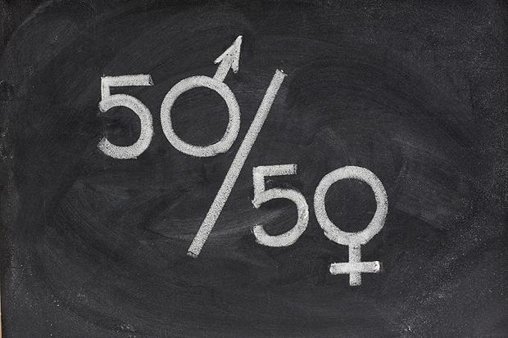
Sex
The Act protects both men and women from discrimination because of their sex.
Sex refers to the gender of an employee.
Notes:
OPTIONAL
The Equality Act protects both male and female employees from discrimination, harassment and victimisation relating to sex. For example, an employer must ensure their managers to do not favour team members of a particular gender.

Slide 32

Job Advertisements
Care with wording that is not discriminatory
Is there a genuine occupational requirement
Are you taking positive action to encourage applicants from under-represented groups?

Slide 33
Genuine Occupational Requirements
- job advertisements
Must be:
Crucial to the post;
Relating to the nature of the job not the culture of
the organisation;
You have a real business need and what you are proposing is appropriate, reasonable, necessary and fair (“Proportionate means of achieving a legitimate aim”)
Notes:
Very rare, but it is possible to justify direct discrimination due to an occupational requirement…matching intrinsic ‘occupational requirements’ of the job.
In certain and rare circumstances, it may be lawful for an employer to specify that applicants for a job must have a particular aspect of a protected characteristic, or a particular protected characteristic itself, under the Equality Act. In law, this approach is known as an ‘occupational requirement’.
Examples might include specifying a practising Catholic to work as a chaplain in a Catholic chaplaincy at a university. Or, specifying a young actress for a film role as a young woman of a certain age.
However, it is not enough for an employer to simply decide they would prefer to employ someone who has a particular aspect of a protected characteristic, or a particular protected characteristic itself. The requirement must be:
crucial to the post, and not just one of several important factors and;
relating to the nature of the job, rather than the culture of the employing organisation and;
a ’proportionate means of achieving a legitimate aim’. If there is any reasonable and less discriminatory way of achieving the same aim, it is likely that the employer could not claim an occupational requirement.
All three points apply to an occupational requirement, not just one or two of them.
An occupational requirement must be reassessed each time, even though it may have been valid for the same post in the past. Circumstances may have changed, meaning the occupational requirement may no longer be applicable.
Also, in terms of good practice, employers should see ‘a proportionate means of achieving a legitimate aim’ as very much a last resort. It is also important to stress that employers should carefully monitor their policies and practices, otherwise they may inadvertently indirectly discriminate.

Slide 34
Interviews
Reasonable adjustments required before interview or selection process?
Flexibility with interview dates/times
Don’t ask about someone’s protected characteristics unless very clearly related to the job
Don’t ask about health, sickness or disability records – if disabled, focus on person’s ability to do the job and what RA are needed
Avoid making instant and unfair judgments as soon as someone arrives – establish their skills, qualities & experience
Keep record of interview and notes for 12 months

Slide 35

Questions to avoid in interviews
Are you married?
How old are you? What is your date of birth?
How many children do you have?
What does your husband do? What does he think of you applying for this role?
How do you feel about managing a team of younger people?
What church do you go to?
When do you plan to retire?
Which political party do you belong to?
Notes:
Equality & Human Rights Commission (2014) It’s a myth that equality law says you must ask everyone exactly the same questions. There is no reason for you not to ask about things that are different for a particular candidate, or follow up an applicants with questions that related to what they have just said. However you should be focussing on the same broad subject areas with each applicant. This is because you will be applying different standards to different applicants based on their protected characteristics and this may lead to unlawful discrimination.

Slide 36

Liability
Personal employee liability for the discriminator/harasser/victimiser
Vicarious liability for employer for acts “in the course of employment” unless defence that all reasonable steps taken can be shown
Criminal liability for false or misleading statements (£5k)
Reputational and/or financial risks

Slide 37

EASS statistics
Equality & Advisory Support Service 2017
96% - cases resolved informally
3% - EASS direct intervention
1% - formal resolution
Highlands & Islands Jan – Aug 2018
Disability – 87.5%
Gender – 7.5%
Pregnancy & Maternity – 2.5%
Race – 2.5%

Slide 38
Next steps
Train you, employees and contractors in equality issues
Review policies/practices, written or not
Review website & advertisements; check wording; think about inclusive pictures
Consider having an equality policy
Review your accessibility for disability and make your customers aware
Consider reasonable adjustments carefully – take advice
Be sensitive to needs; ask/listen
Make sure complaints are dealt with; manage poor behaviours

Slide 39
Can we reverse the trend through equality?

